Slide 1
DSP PROJECT PRESETATION
AUDIO DENOISING USING STFT
By: M. Faraz Malik (22-CP-47)

Slide 2
OUTLINE
Overview
Introduction
Methodology
Challenges and Limitations
Further Improvements
Applications
Conclusion
References

Slide 3
Project Overview
Objective: Develop an audio denoising algorithm using Short-Time Fourier Transform (STFT)
Motivation: Improve audio quality by removing unwanted noise from audio signals
Technique: Spectral Subtraction with Advanced Noise Estimation

Slide 4
Introduction
Short-Time Fourier Transform (STFT)
A time-frequency analysis technique that breaks a signal into short, overlapping segments
Allows analysis of signal characteristics at different time-frequency points
Key parameters:
Window function (Hamming window used)
Window length
Overlap between windows
Number of FFT points

Slide 5
Audio Denoising Pipeline
Steps in the Algorithm:
Load the Noisy Audio: Read the input signal (Recording.wav).
STFT Transformation: Compute the spectrogram of the noisy signal.
Noise Spectrum Extraction: Identify and average noise from specific intervals.
SNR Estimation: Estimate Signal-to-Noise Ratio (SNR).
TF Attenuation Mapping: Apply attenuation based on SNR to suppress noise.
Inverse STFT: Reconstruct the denoised audio.

Slide 6
Applying STFT
Noise spectrum extraction & Average noise Intervals
Inverse STFT and reconstructed denoised Audio
Attenuation & noise suppression
SNR estimation & Calculation
Denoised audio as output
Loud noisy audio

Slide 7
Working
Apply STFT:The Short-Time Fourier Transform (STFT) converts the signal into the time-frequency domain by computing the Fourier Transform in small overlapping windows.
Estimate Noise Spectrum:Noise power is estimated from a predefined interval of the signal assumed to contain only noise.The noise spectrum is then replicated across all frames to serve as a reference for noise reduction.
t_index = find(T > t_min & T < t_max);
mgntopwr = abs(S(:, t_index)).^2;
noisyspec = mean(mgntopwr, 2);
acrsallwndows = repmat(nosyspec, 1, Nw);

Slide 8
Working
SNR estimation begins by calculating the magnitude squared of the Short-Time Fourier Transform (STFT) which provides the power spectrum of the signal.
Then, the estimated noise spectrum is used to compute the Signal-to-Noise Ratio (SNR) for each bin.
To stabilize and adapt this SNR estimate over time, a low-pass filter is applied using S with the parameter alpha controlling the smoothing factor.
absS = abs(S).^2;
SNR_est = max((absS ./ acrsallwndows) - 1, 0); SNR_est = filter((1 - alpha), [1 - alpha], SNR_est);

Slide 9
Working
Adaptive Time-Frequency Attenuation:A gain map is calculated using the estimated SNR, controlling the attenuation of noise in the signal.
Parameters like λ (lambda), β1, and β2 control the degree of attenuation applied, shaping how noise is suppressed based on the SNR values.
Inverse STFT process involves iterating through the modified frequency bins, applying the inverse Fourier transform to each, and then using the overlap-add method to reconstruct the time-domain signal smoothly..
an_lk = max((1 - lambda * ((1 ./ (SNR_est + 1)).^beta1)).^beta2, 0);
STFT = an_lk .* S;

Slide 10
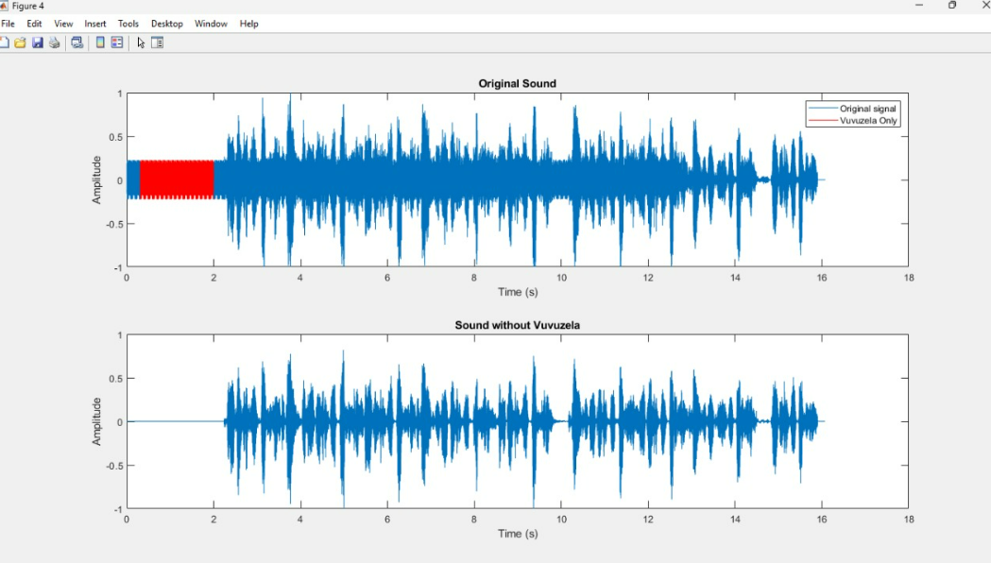
Output

Slide 11
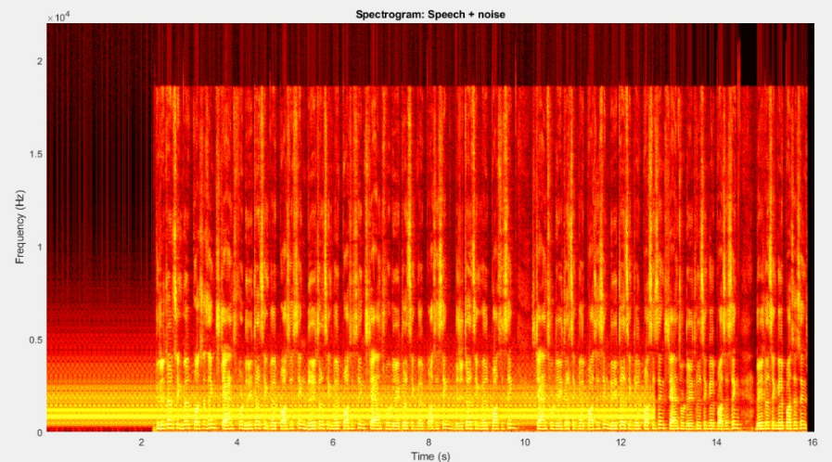
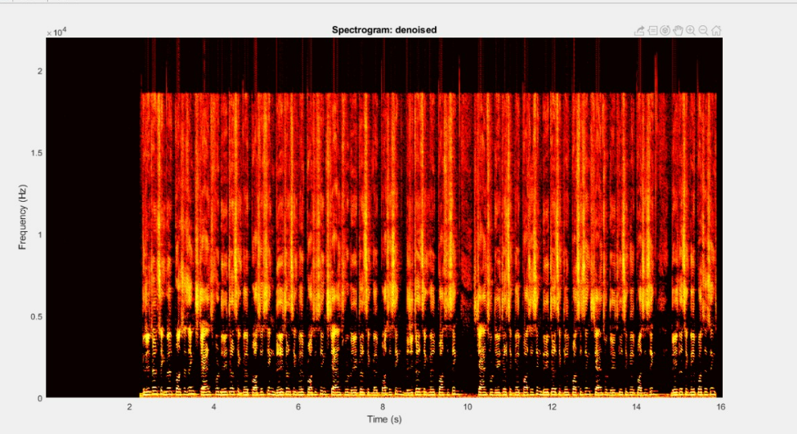
Noisy Spectrogram
Denoised Spectrogram

Slide 12
Challenges and Limitations
Performance depends on noise characteristics
Potential artifacts in highly noisy signals
Sensitive to parameter selection

Slide 13
Future Improvements
Adaptive noise estimation
Machine learning-based noise reduction
Real-time processing optimization

Slide 14
Applications of Audio Denoising
Real-World Use Cases:
Speech Enhancement in Telecommunication
Noise Reduction in Hearing Aids
Audio Restoration for Archival Records
Signal Processing in Autonomous Systems (e.g., Speech Commands)

Slide 15
Conclusion
Successfully implemented STFT-based audio denoising
Demonstrated effective noise reduction
Flexible and configurable approach

Slide 16
References
Cohen, I. (2021). Noise Spectrum Estimation in Adverse Environments
Loizou, P. C. (2023). Speech Enhancement: Theory and Practice MATLAB Signal Processing Toolbox Documentation

Slide 17

Open floor for QUESTIONS!!
THANK YOU

